Slide 1
Energy Based Location Prediction
Team Members
Gayatri Sivaraman
Jayant Bedwal
Shailesh Kelkar
Srihari Venugopalan

Slide 2
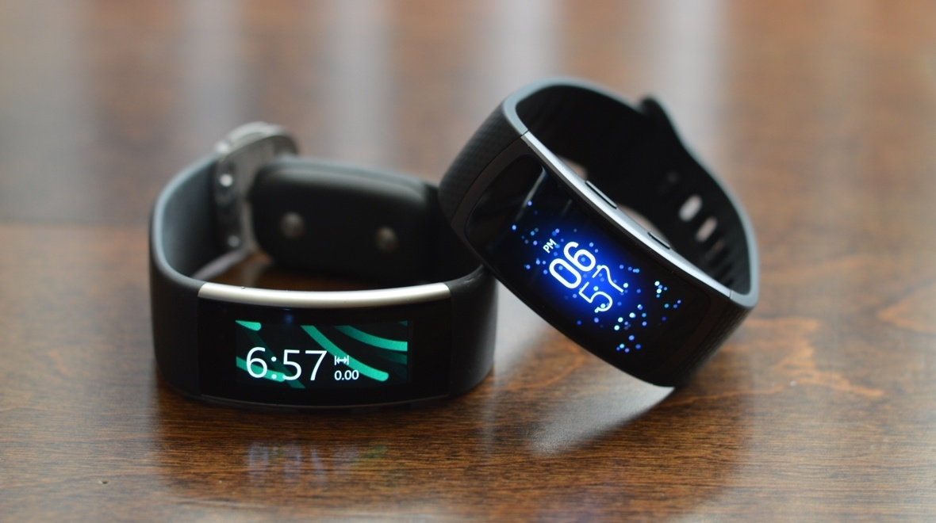
Introduction
Inertial Sensing for Activity Recognition
How Location is sensed generally?
Can the two be linked?

Slide 3
Motivation
Most of the research in this area uses infrastructure mediated sensing
Example : Wifi signals, microphone, camera
Privacy is a major problem
Our idea was to analyze whether the activity being performed has a correlation to the location where it is being performed

Slide 4
The Pipeline
Data Recording
Preprocessing (Filtering)
Frame Extraction
Feature Extraction
Classification
Result

Slide 5
Data Collection
Device used – Microsoft Band , Sensus Application
10 volunteers
Locations
Classroom
Library (Reading, stacking books)
Grocery Store
Recreation center/Gymnasium

Slide 6
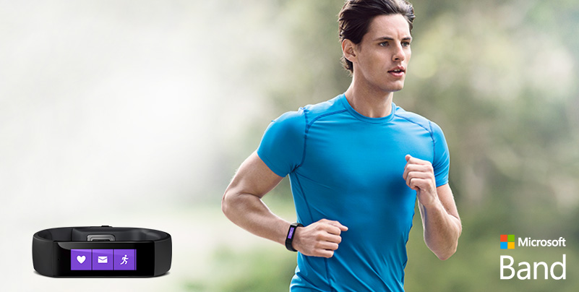
Sensors used
Accelerometer
Gyroscope
Skin Temperature
Heart Rate sensor

Slide 7
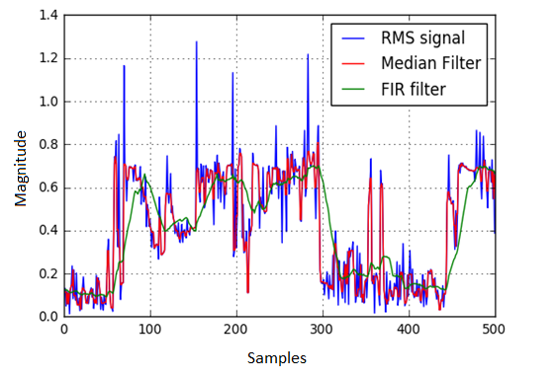
Preprocessing
Median Filter
FIR Filter (Rectangular)
Filt Filter
L Filter
We finally used FIR Filter for Gyroscope data and Median Filter for Accelerometer values

Slide 8
Feature Selection
We extracted the following 22 features from our dataset
Mean (accelerometer, gyroscope, heart rate, skin temperature)
Variance (accelerometer, gyroscope)
RMS (accelerometer, gyroscope)
Mean and variance of RMS ( accelerometer only)

Slide 9
Feature Extraction
Initially, through trial and error we found a range of Frame size and Overlap size
Frame size 50 to 200, at increments of 5 Step size 25 to 100 at increments of 5
Extracted features from each dataset for all these combinations

Slide 10
Test Data
Split Train Test technique
Randomly chose a point within the dataset, extracted a block of data of size = 1/10th of total dataset from this point
Deleted this test data block from the training data, thereby making sure that there is no overlap at all between training and testing data

Slide 11
Training the Classifier
The training data was then labeled and shuffled completely
Trained and tested using different classifiers iteratively for different combinations of frame size and step size
Classifiers used:
SVM (RBF Kernel)
KNN ( N_neighbors= 4)
Random Forest (n_estimators =10)

Slide 12
Accuracy Plot

Slide 13
Results
Classifier | Accuracy (Person Independent)
SVM (RBF kernel) | 58%
K- NN (K=4) | 72.28%
Random Forest | 79.04%
Notes:
Person dependent: SVM- 18%, KNN- 54%, RF= 49%

Slide 14
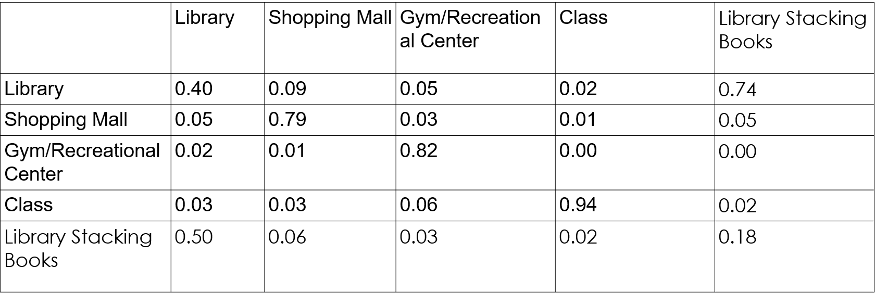
Confusion Matrix
KNN 105,75
KNN- Frame size= 105, Step size = 75

Slide 15
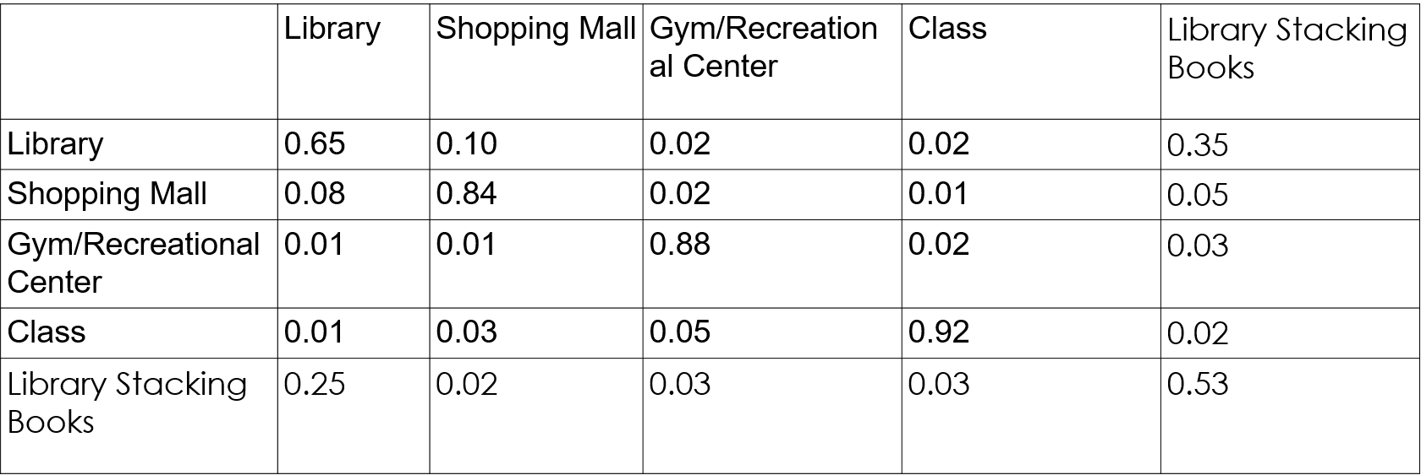
Confusion Matrix
Random Forest- Frame size= 90, Step size = 80

Slide 16
Future Work
More locations with data collected by more volunteers to see how well it performs with increased number of locations with similar activities being performed
Add barometer, magnetometer sensor, it can be used to find out the exact floor in the building based on those readings

Slide 17
Questions?

